Slide 1
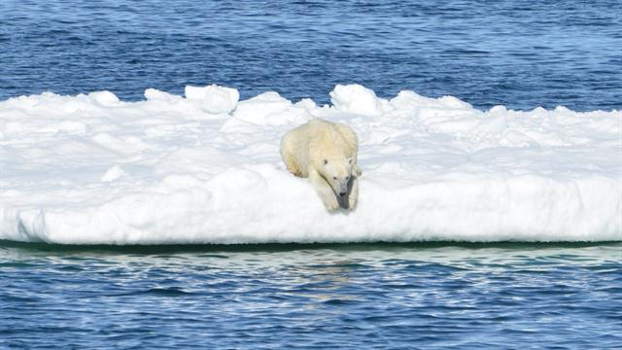
IMPACT OF SEA-LEVEL RISING DUE TO GLOBAL WARMING – A GEOSPALIAL APPROACH
BY
S.SUDHARSAN
Department of remote sensing,
Bharathidasan University,
Trichy-INDIA.
Venus: FOSS4G Korea 2020 zoom platform.

Slide 2
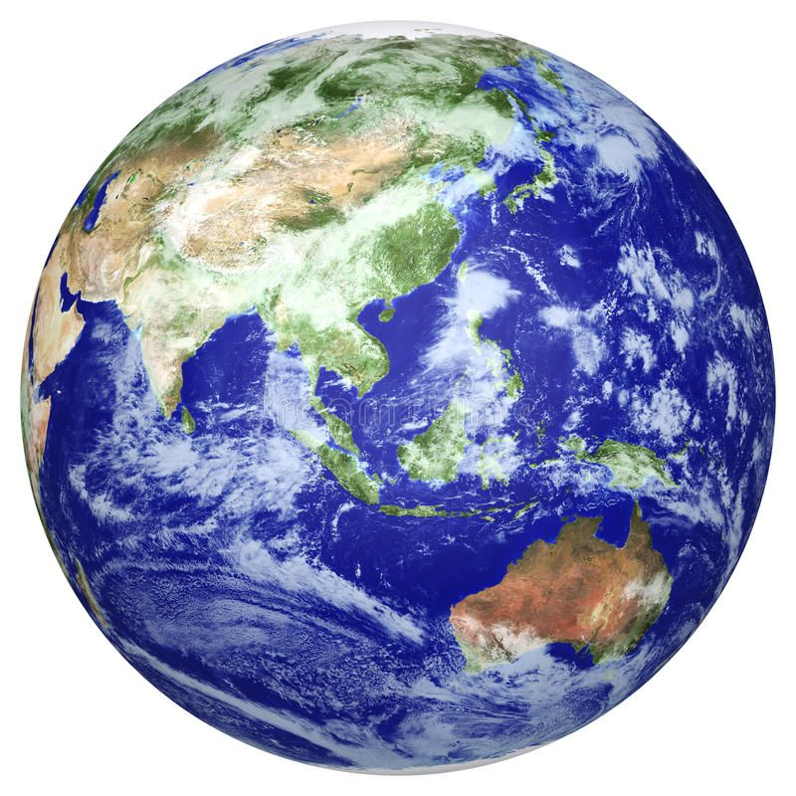
CONTENT
Introduction
Study Area
Methodology
Thematic Maps
Suggesting measures
Conclusion

Slide 3

INTRODUCTION
Nowadays, the sea level rise is a prominent issue faced due to the anthropogenic activities, which leads to the imbalance of oceanic current.
This affects the life cycle of the marine organisms and the increase in amount of carbon dioxide leads to high sea surface temperature.
The study proposed the depletion of ice boundary in the Antarctic peninsula. The shoreline change analysis is performed for 1997 and 2020.
This research also correlated the land surface temperature with the depletion of glacial layer by using the linear regression analysis.

Slide 4
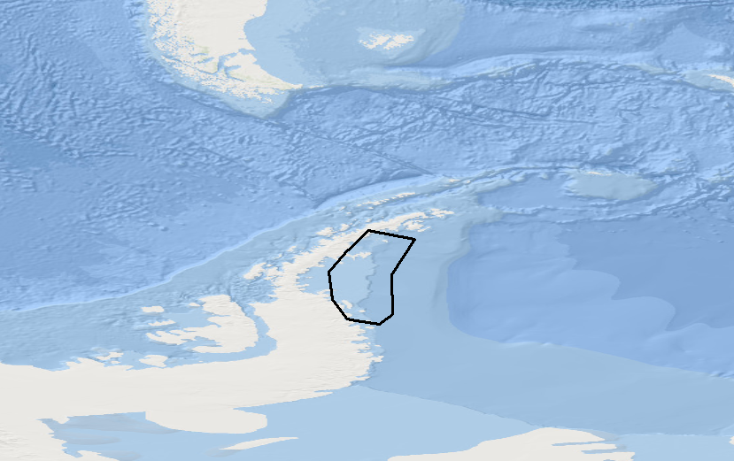
STUDY AREA
The study area is in the Western Antarctic – Antarctic peninsula.
Latitude:-66.819611
Longitude:-63.638668
Area:-166500 Km
For the study area the nose part of the Antarctic peninsula region is taken in the eastern side is covered Weddell sea where more changes occurs in the area of the land part.
2

Slide 5
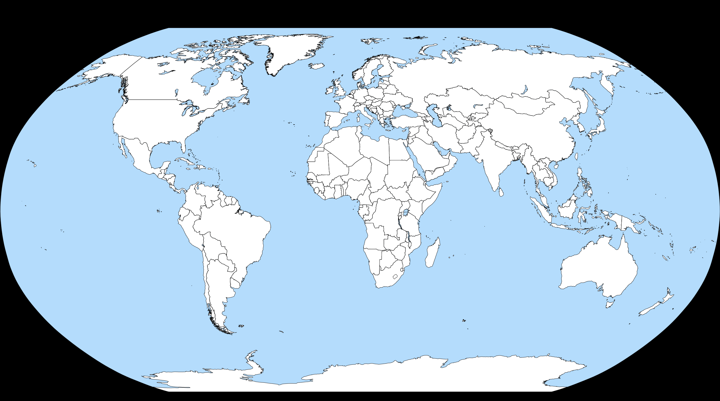
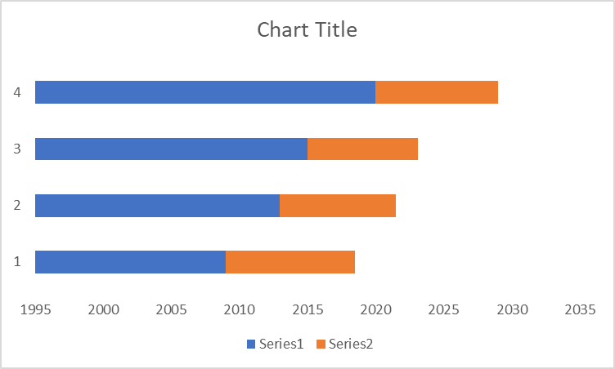
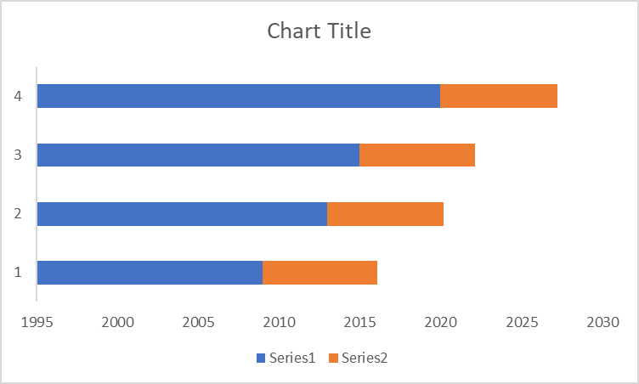

Slide 6
METHODOLOGY
Satellite Data
Ancillary Data
Landsat5,8
DEM
Annular Global Temperature
Annular Global sea-level data
Ocean current
NCC
NDVI, Thermal Band
Integrating all Layers
Geomorphology
LST
RE
G
RE
SS
I
O
N
M
O
D
E
L
Estimating the melt with relate to the
Sea-level.
Shoreline

Slide 7
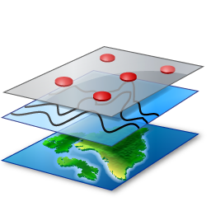
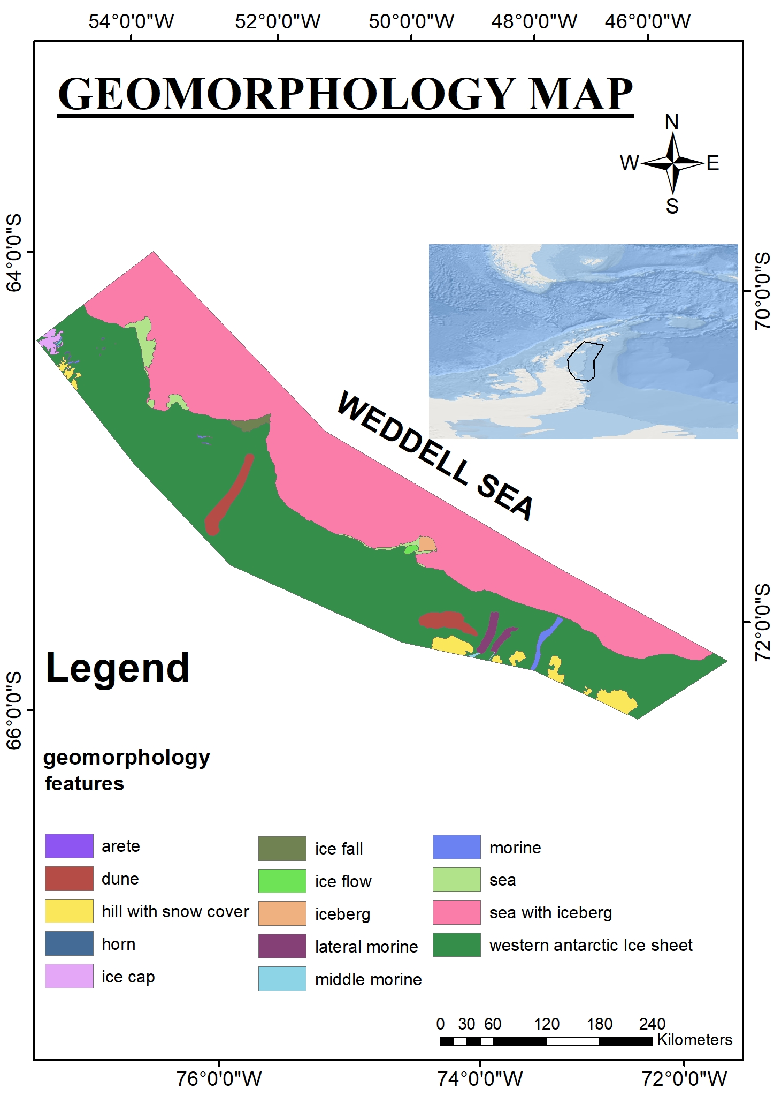
THEMATIC MAPS
The first map is the geomorphology map, which can gave a understand about the basic geo-process in this area.
Important feature identification:
Dune,
form the trend direction of the dunes in the study area are E,W and other in NE, NW will gave a wind direction in curvilinear pattern.
Lateral Moraine,
form this lateral Moraine at SE path of the study area with out a solid block of ice which indicate the historical glacier movement of huge block movement.
Ice fall,
A huge ice sheet is fall slowly which area of 820Meters and which indicates the intensity of rise in global warming.

Slide 8
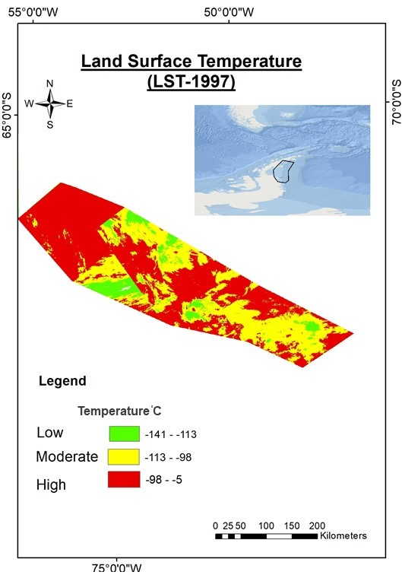
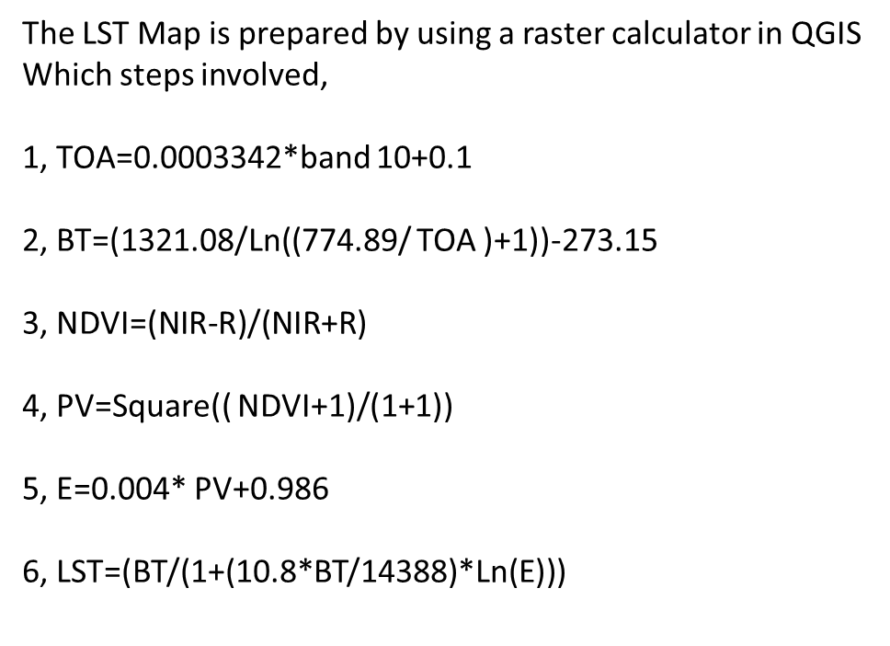

This LST of 1997 will be classified in to major three class of
Low, moderate, high the average temperature is -75֯ Celsius. In that the temperature high region is more because in that time the snow sheet in the Weddell sea is not there.

Slide 9
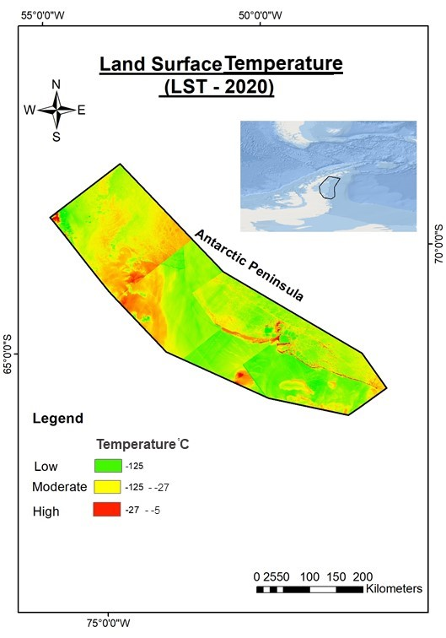

In the study area the average temperature is -65 ֯ Celsius is highly recoded temperature of 30/2/2020.
Both data are collected in summer season of the Antarctic Peninsula at February.
By comparing the both data we can understand that the average mean temperature of -10 ֯ Celsius has been decreased in lase 20 decades .which mean per year approximately -0.5 ֯ Celsius has decreases with increase in temperature.

Slide 10
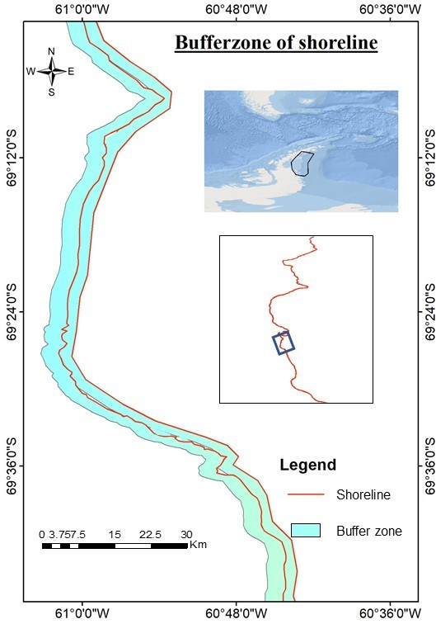
Amount of M/A (mm)
2.5m
Here from the graph represents the Melting and Accretion of the study area are prepared (using erosion & Accretion from the points in QGIS) in that we clearly observe there when the melting decreases in with increases in the Accretion of the ice-sheet which is depend on the thickness of the ice-sheet and temperature condition of the region.

Slide 11
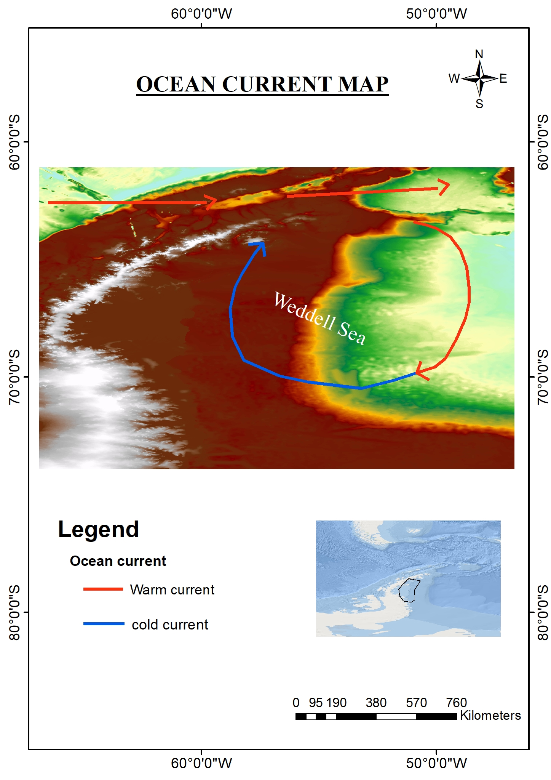
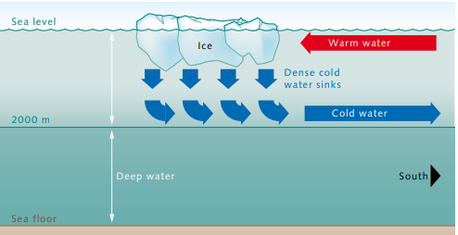
The ocean current Map will give a understand about the distribution of cold and warm current along the Weddell Sea of the Antarctic Peninsular.
This current will move the icebergs to the noise point (i.e: NE part) then the warm current will melt the glaciers.
Due to thermohaline circulation, the denser cold water sink to sea.

Slide 12
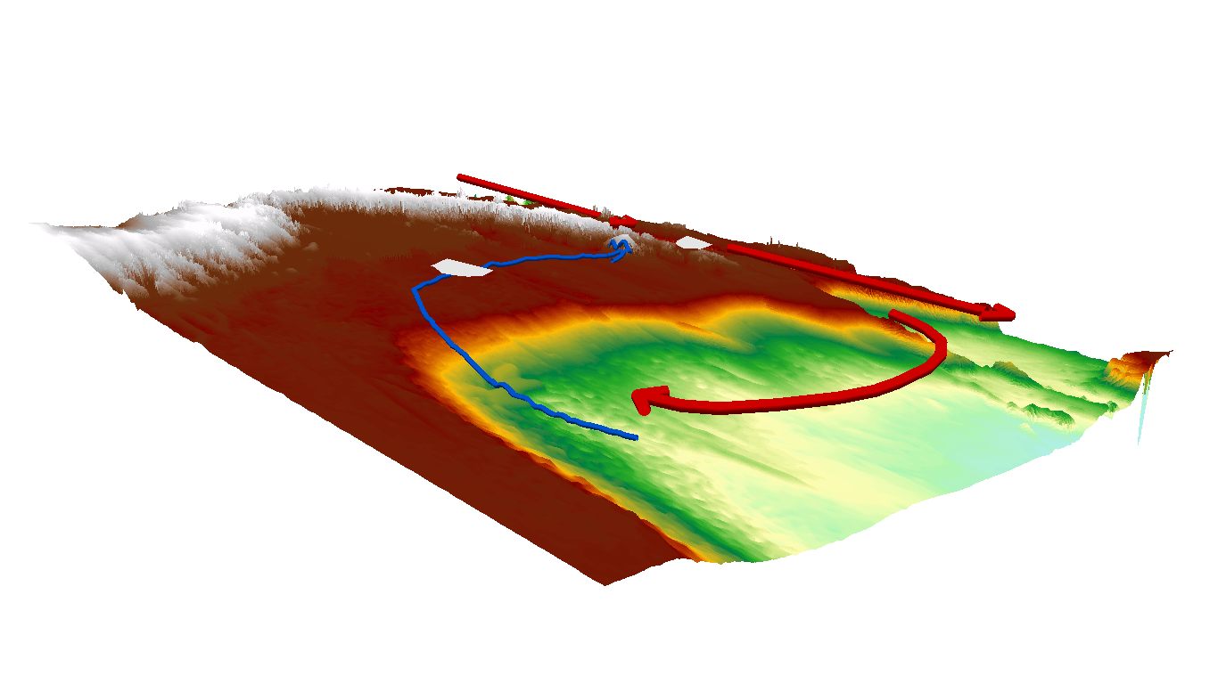
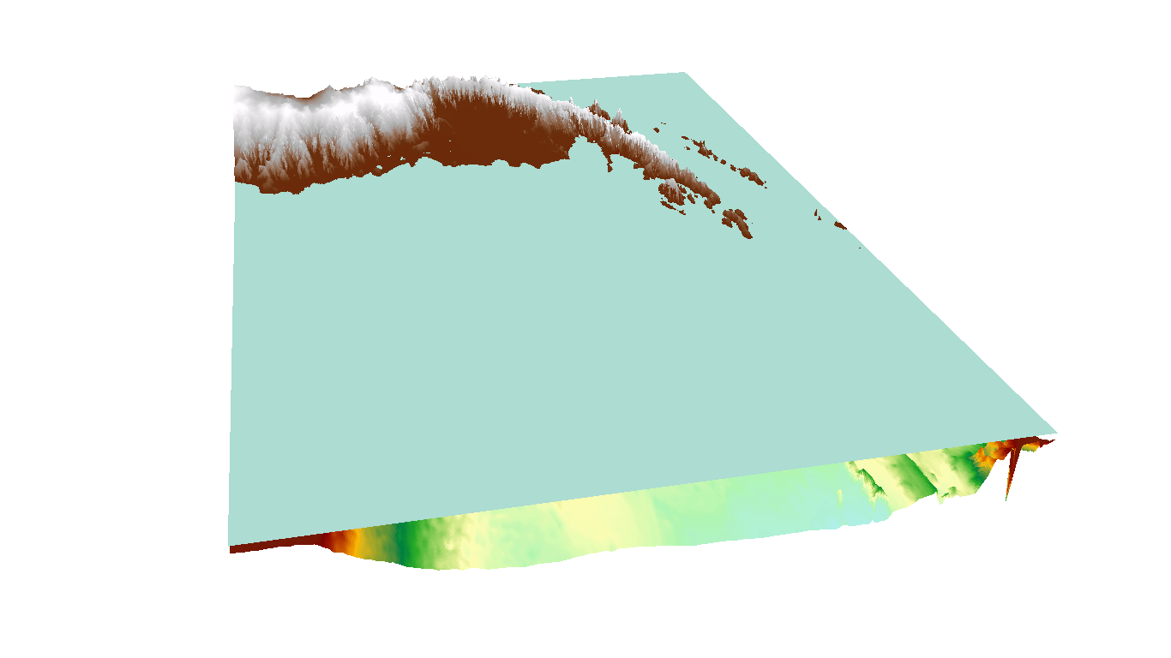
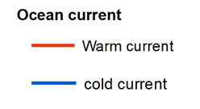
3D Modeling of the Antarctic Peninsular region
The 3D map illustrate the trend of the ocean current.
The present day sea level.

Slide 13
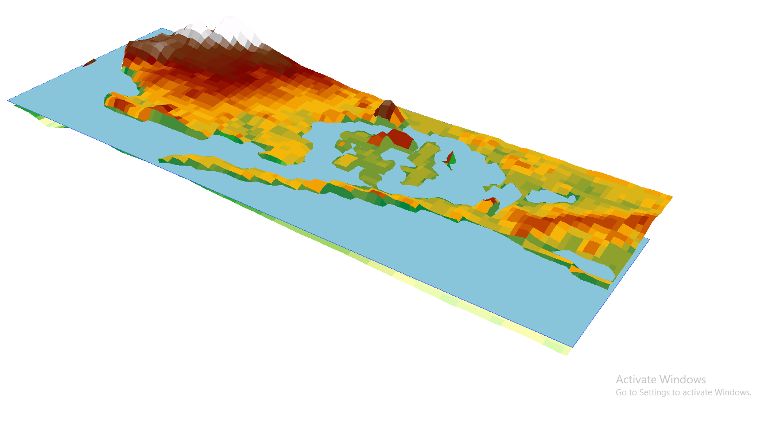
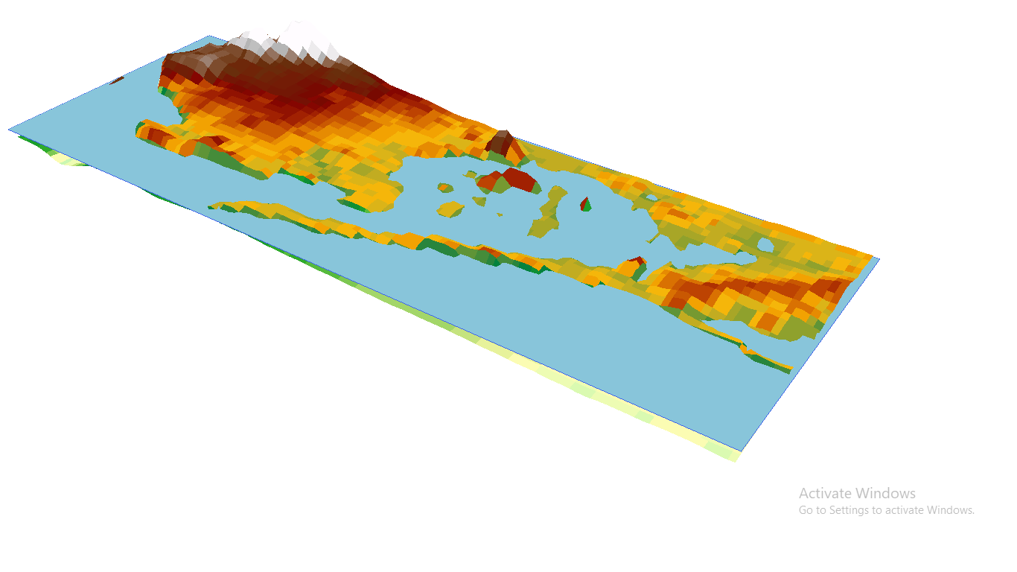
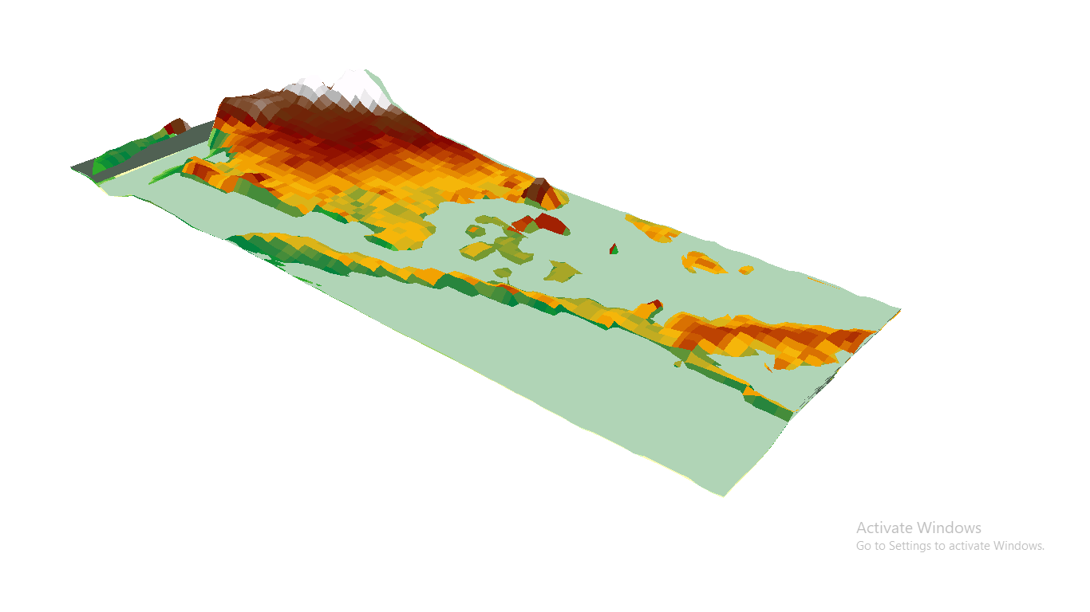
East New York
East New York
1997 sea-level
2020 sea-level
1997 to 2020
For the last 20 year the sea-level rise in new York city will be 0.6 feet (20 cm). The scientist said that if this trend of global temperature increases there will be a possible of rise in 2feet.
East New York
Model of 1feet in rise.

Slide 14
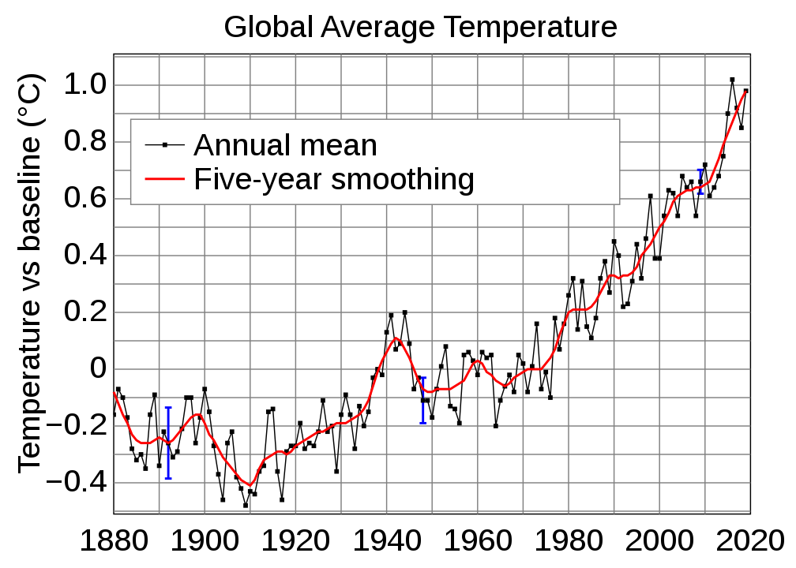
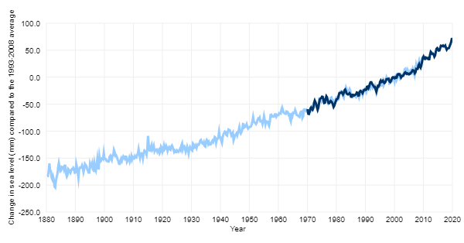
Correlation between the Global Average Temperature & Global Average sea-level
Global Average Temperature
Global Average sea-level

Slide 15

The trend between this two graph gave a rhythmic pattern.
After 1970’s to present 2020 we able to note that drastic increase in the graph.
The global temperature of min -0.4 ֯ C to max 1.0 ֯C and the global sea-level raise of min -200mm to max 70mm in ranges.
Due to change in forest area, industries, and automobiles which are the major factors that influencing the global sea-level.

Slide 16
SUGGESTING AN MITIGATION MEASURES:
The important think that influence the global temperature is due to Co2 emission, which can be naturally decrease by planting trees.
we found one method by chemically which is produce 1 oxygen molecule from 100 Co2 molecules.
Atomic carbon
Oxygen molecule
+ -
Particle accelerator
Co2
Gold foil
Electric field

Slide 17


CONCLUSION
By taking an ocean current interactive area, for that the relationship between global warming to glacier melting is studied using the geospatial techniques (QGIS).
From the small area an impact of large which is maximum 3 ft of shore had been melted in the recent 20 years.
We also suggested one important method to reduce the intensity of increase in global temperature.

Slide 18

Thank you for the FOSS4G Korea.
Reference:
https://worldoceanreview.com/wp-content/downloads/wor1/WOR1_en_chapter_1.pdf
Sweet W. V., J. Park, J.J. Marra, C. Zervas and S. Gill (2014). Sea level rise and nuisance flood frequency changes around the U.S. NOAA Technical Report NOS CO-OPS 73, 53p. [Online: https://tidesandcurrents.noaa.gov/publications/NOAA_Technical_Report_NOS_COOPS_073.pdf]
Church, J. A., and White, N. J. (2011). Sea-Level Rise from the Late 19th to the Early 21st Century. Surveys in Geophysics, 32(4-5), 585–602. http://doi.org/10.1007/s10712-011-9119-1
https://sealevelrise.org/states/new-york/
https://tidesandcurrents.noaa.gov/sltrends/sltrends_station.shtml?id=500-091
https://www.Caltech.edu/about/news/comet-inspires-chemistry-making-breatable-oxygen-mars.

